Slide 1

Introduction to AI(AI101B) Even Semester Session 2024-25
Image Captioning System
Team Leader: Priyanshu Asthana (2426MCA1495)
Member: Sakshi Khandelwal (2426MCA697)
Member: Sanya Dwivedi(2426MCA204)
Project Supervisor:
Ms. Komal Salgotra
Assistant Professor

Slide 2

Image Captioning Systems: Bridging Vision and Language
Bringing together visual content and natural language descriptions to enhance accessibility and interaction.
This presentation covers system overview, key models, challenges, and future possibilities.

Slide 3


Motivation: Why Image Captioning?
Accessibility
Image Retrieval
Enables descriptions for visually impaired users to understand images.
Improves search via semantic understanding of image content.
Human-Computer Interaction
Applications
Helps robots and AI systems interpret scene information.
News captioning, social media accessibility, and assistive devices.

Slide 4
Architecture: Encoder-Decoder Framework
Encoder
Decoder
CNNs extract visual features from images.
RNNs generate captions word by word.
Popular CNNs: ResNet-50, InceptionV3
Variants: LSTMs, GRUs
Pre-trained on large image datasets
Use attention mechanisms for focus

Slide 5

Detailed Encoder: CNN Feature Extraction
Pre-trained CNNs
Fine-tuning
Use ImageNet models as feature extractors for fast training.
Adapt CNNs to specific datasets to boost accuracy.
Object Detection
Training Data
Faster R-CNN identifies key regions for improved context.
Visual Genome dataset provides rich region annotations.

Slide 6
Detailed Decoder: RNN Caption Generation
LSTM / GRU Networks
Attention Mechanisms
Beam Search
Training Strategies
Selects most probable sentence among candidates.
Uses teacher forcing or scheduled sampling techniques.
Sequentially generate words using learned context.
Focus on relevant image areas dynamically.

Slide 7





Attention Mechanisms
Soft Attention
Hard Attention
Self-Attention
Assigns weights to all image parts simultaneously.
Focuses on one key region at a time.
Models relationships across image components.
Transformers
Captures long-range dependencies effectively.

Slide 8
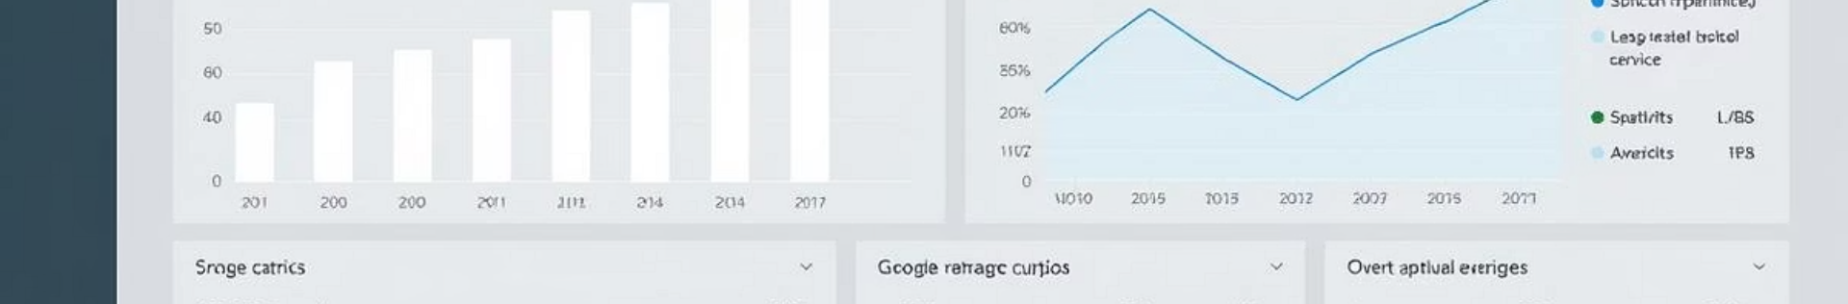
Evaluation Metrics
Metric
Description
BLEU
Precision-based n-gram overlap with references
ROUGE
Recall-focused n-gram matching
METEOR
Includes synonyms and stemming
CIDEr
Evaluates consensus similarity among captions
SPICE
Semantic propositional evaluation
Human evaluations remain crucial for assessing quality subjectively.

Slide 9





Challenges and Limitations
Bias and Fairness
Complex Scenes
Ensuring unbiased and fair descriptions is crucial.
Image Quality
Handling multiple objects and relations is challenging.
Robustness to noise and low-quality inputs must improve.
Diverse Language
Generating creative and varied captions is difficult.
Data Scarcity
3
Large, diverse captioned datasets are limited.
2
4
1
5

Slide 10

Recent Advances and Future Directions
Controllable Generation
Multimodal Approaches
Customize captions based on user preferences.
External Knowledge
Use audio and text cues for richer captions.
Transformers
Incorporate commonsense and real-world context.
Deliver improved efficiency and caption quality.
Examples include ClipCap, X-GPT, and BLIP models.

Slide 11

Conclusion
Impact
Applications
Bridges vision and language for accessibility and search.
Empowers human-computer interaction and assistive tools.
Future
Focus on creativity, robustness, and user control.

